Slide 1
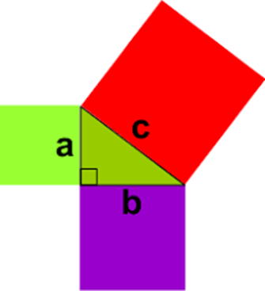
My Pythagoras Interactive Notebook
Name:
Class: 9-9
Term 2 Semester 1

Slide 2
Warm Up
Evaluate 7²
What is the square root of 36?
What angle is the hypotenuse opposite?
3² + 4² = ?²

Slide 3
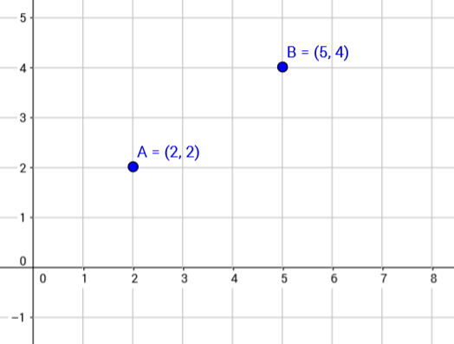
24
7
30
Date
Using Pythagoras on a graph
EQ – How can I apply Pythagoras’ theorem to find the length of a line on a graph?
To find the length of AB I can break this down into the horizontal and vertical components

Slide 4
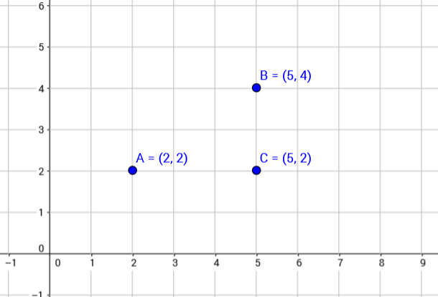
24
7
30
Date
Using Pythagoras on a graph
EQ – How can I apply Pythagoras’ theorem to find the length of a line on a graph?
Put in a new point C and draw a right angle triangle

Slide 5
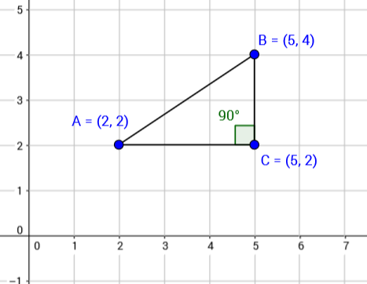
24
7
30
Date
Using Pythagoras on a graph
EQ – How can I apply Pythagoras’ theorem to find the length of a line on a graph?
Now to find the length from A to B (line AB) I can use Pythagoras

Slide 6
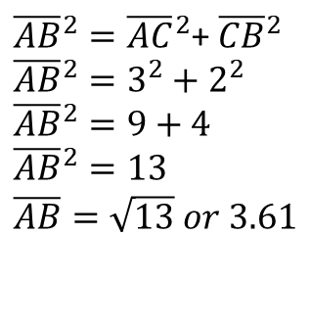
24
7
30
Date
Using Pythagoras on a graph
EQ – How can I apply Pythagoras’ theorem to find the length of a line on a graph?
Now to find the length from A to B (line AB) I can use Pythagoras
${\overline{AB}}^{2}={\overline{AC}}^{2}$+ ${\overline{CB}}^{2}$
$${\overline{AB}}^{2}=3^{2}+2^{2}$$
$${\overline{AB}}^{2}=9+4$$
$${\overline{AB}}^{2}=13$$
$$\overline{AB}=\sqrt{13} or 3.61$$

Slide 7
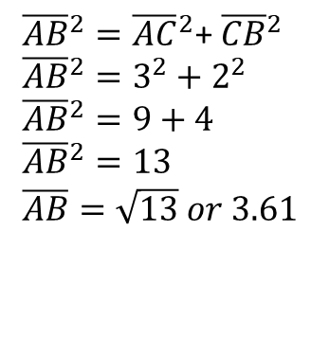
24
7
30
Date
Using Pythagoras on a graph
EQ – How can I apply Pythagoras’ theorem to find the length of a line on a graph?
Now to find the length from A to B (line AB) I can use Pythagoras
${\overline{AB}}^{2}={\overline{AC}}^{2}$+ ${\overline{CB}}^{2}$
$${\overline{AB}}^{2}=3^{2}+2^{2}$$
$${\overline{AB}}^{2}=9+4$$
$${\overline{AB}}^{2}=13$$
$$\overline{AB}=\sqrt{13} or 3.61$$
Complete Ex 7.5 pg 94. Hint: plot each point first!

Slide 8
Notes Review
24, 7 ,30
Date
Title
Essential question
Notes complete
Notes complete with colour and diagrams
Questions completed
Contents page filed in
Formula page filled in

Slide 9
Homework
Review your notes and write a summary answering the essential question.
Ex 7.5

